Slide 1
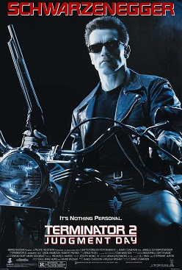

Risk Storming / Pre Mortem Workshop
Preparation:
Read the Story of Terminator 2 [1], Check Risk Storming [2] as well as Pre Mortem [3], get some insights about risks [4]… Add Name, Date, Location … [1] https://en.wikipedia.org/wiki/Terminator_2:_Judgment_Day
[2] https://riskstorming.com/
[3] https://en.wikipedia.org/wiki/Pre-mortem [4] https://riskstorming.com/
Name
Date
Notes:
https://en.wikipedia.org/wiki/File:Terminator2poster.jpg#/media/File:Terminator2poster.jpg

Slide 2
Risk Storming / Pre Mortem Workshop
Name:
Date:
Notes:
https://en.wikipedia.org/wiki/File:Terminator2poster.jpg#/media/File:Terminator2poster.jpg
This is a poster for Terminator 2: Judgment Day. The poster art copyright is believed to belong to the distributor of the film, TriStar Pictures, the publisher of the film or the graphic artist, The Cimarron Group. Further details: Promotional poster for James Cameron's 1991 film, Terminator 2: Judgment Day.

Slide 3
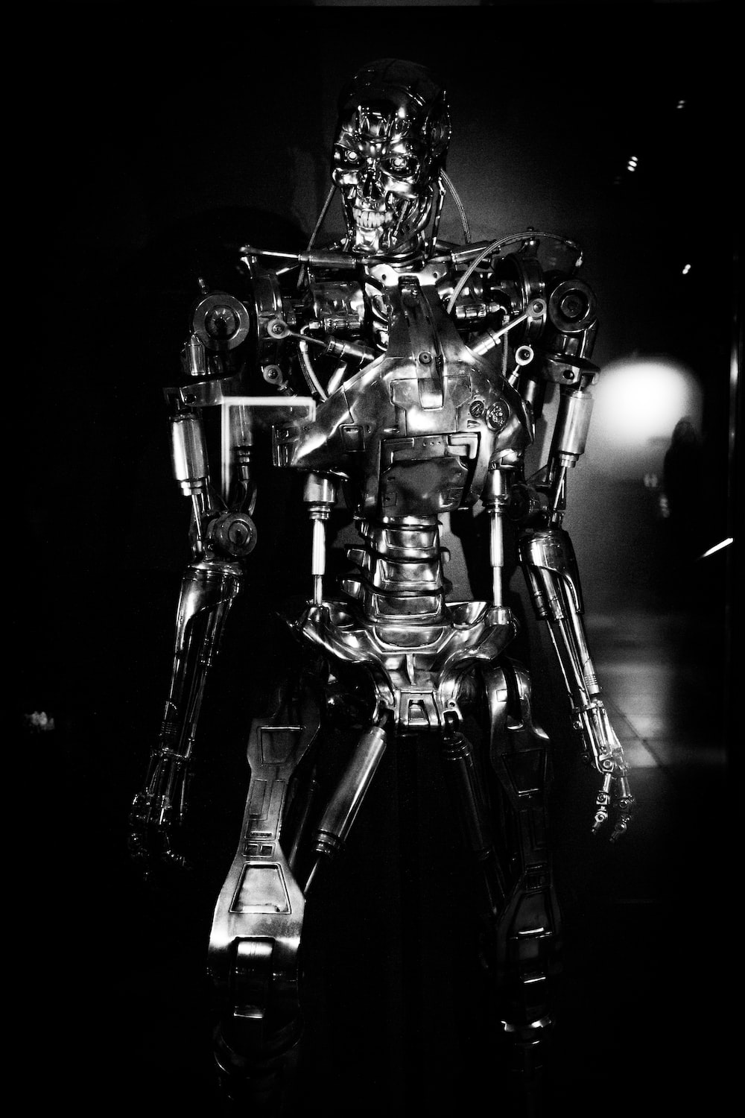
Terminator 2 – T2
Icebreaker:
Explain why Terminator was an iconic movie for you as facilitator or why you chose this workshop. Then let people talk for 4 minutes in pairs of two. Ask for 2-3 people who want to share a their or their partners movie.
Variation: Impromptu Networking, if you have a bit more time. https://www.liberatingstructures.com/2-impromptu-networking/
Was such an iconic movie for me!
What was an iconic movie for you and why? (4 Minutes for you and your neighbour)
Notes:
https://unsplash.com/photos/Oa1saYGuRKU

Slide 4
Terminator 2 – T2
Was such an iconic movie for me!
What was an iconic movie for you and why? (4 Minutes for you and your neighbour)
Notes:
Icebreaker
https://unsplash.com/photos/Oa1saYGuRKU

Slide 5

Risk Storming / Pre-Mortem
Goal:
Identify our Top 10 risks
Order the our risk backlog
Decide how to deal with the risks
Agenda:
Breaking the ice
Agenda
Storming Risks (Liberating Structure: 1-2-4-All) (approx. 20 min)
Rank the risks (Impact and Propability Board), approx. 30 min)
Decide what to do next (15% / 85% Solution) (approx. 30 min)
Outro (approx. 5 min)
Notes:
https://unsplash.com/photos/t9BO_mBKZM4

Slide 6
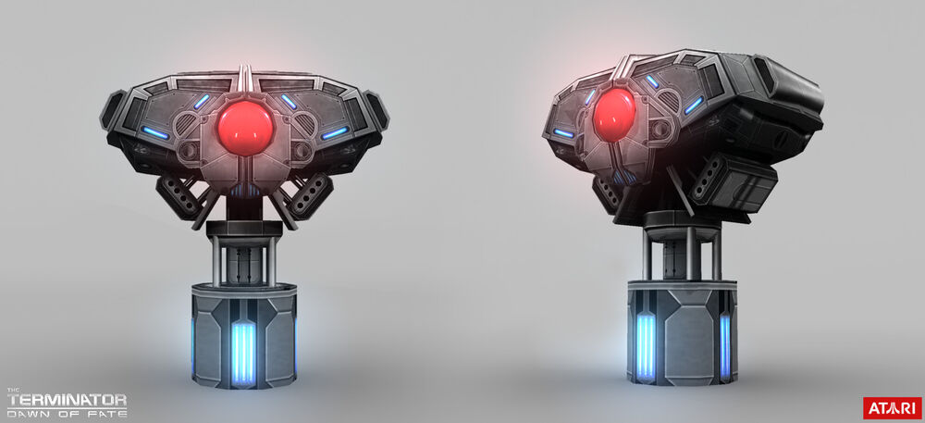
Skynet
Rember the Story of Terminator 2? Tell about Skynet and how it tried to killed humanity! Skynet is a metaphor for your current project.
Notes:
https://terminator.fandom.com/wiki/Skynet?so=search&file=Tdof-skynetbrain-model-01.jpg

Slide 7
Skynet
Notes:
https://terminator.fandom.com/wiki/Skynet?so=search&file=Tdof-skynetbrain-model-01.jpg

Slide 8
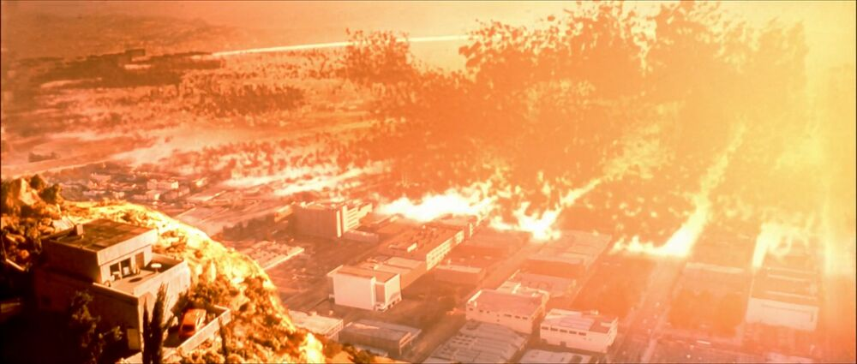
Judgement Day – (1995,1997, 2003, 2004, 2011, 2014, ..)
And Judgement Day is the Day in three years (or a different time) when your projet will fail.
Notes:
https://terminator.fandom.com/wiki/Judgment_Day?file=Terminatorsalvation-302-47.jpg

Slide 9
Judgement Day – (1995, 1997, 2003, 2004, 2011, 2014, ..)
Notes:
https://terminator.fandom.com/wiki/Judgment_Day?file=Terminatorsalvation-302-47.jpg

Slide 10
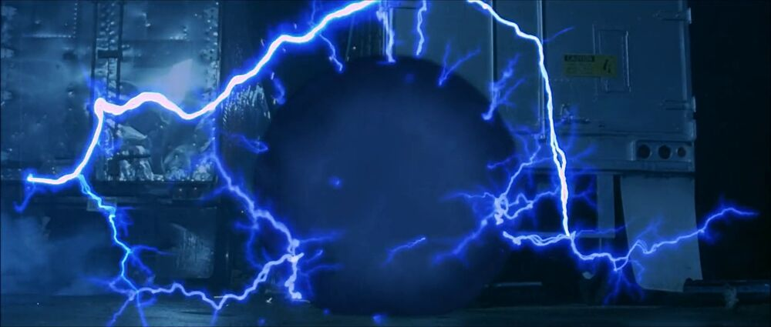
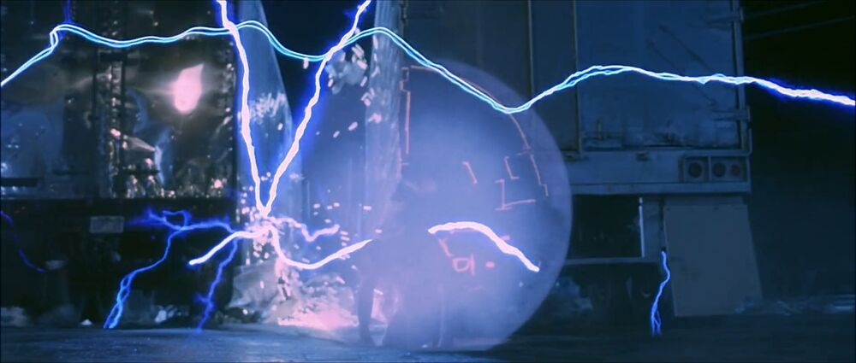
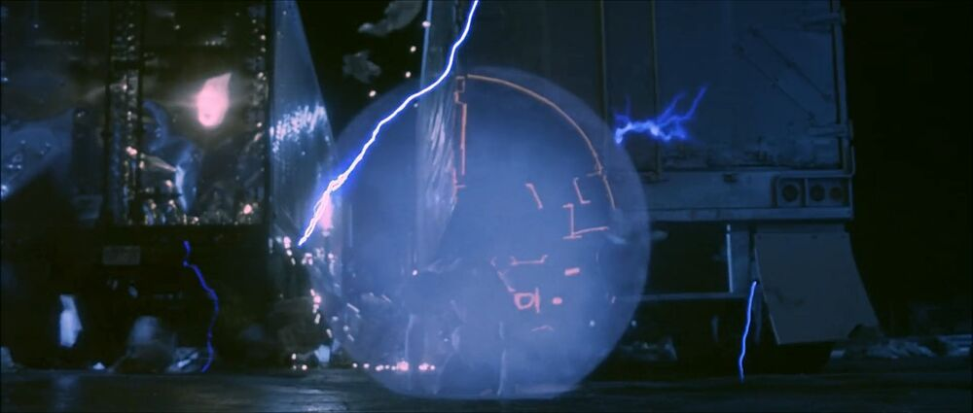
But …
The T800 will come from the future and tell you secrets (risks for your project), why your project will fail.

Slide 11
But …
Notes:
Images: https://terminator.fandom.com/wiki/Terminator_Wiki

Slide 12
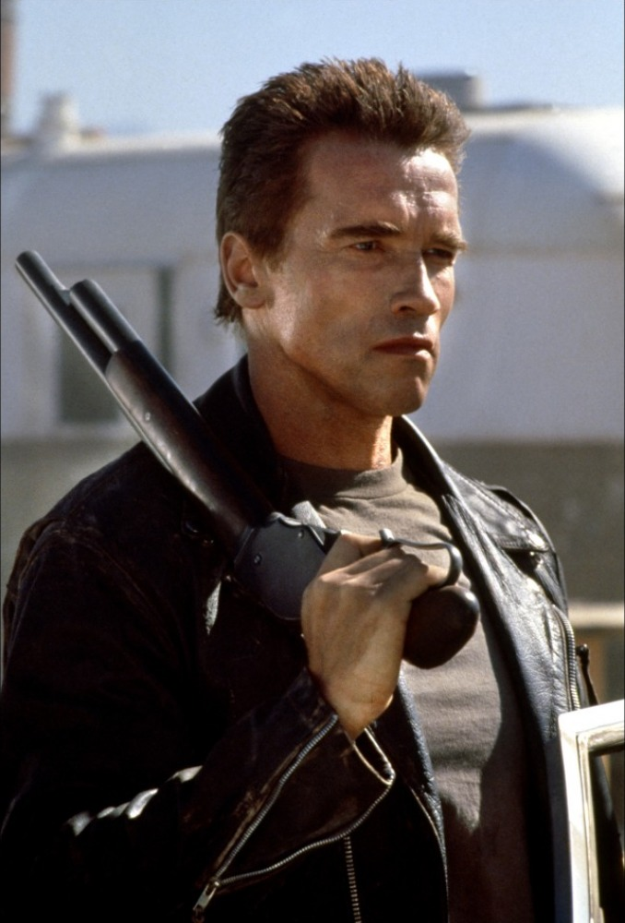
… the T800 warns you!
The T800 warns you! Your project will fail in three years and tells you why!
Now you all will be the T800!
Find the Top 10 risks for your project!
Notes:
https://static.wikia.nocookie.net/terminator/images/8/82/UncleBob.jpg/revision/latest?cb=20110112050758

Slide 13

1-2-4-All
Check the Liberating Structure 1-2-4-All [1] This will take 18-20 Minutes. Result are 10 risks not ordered. It works up to 25 people. Don‘t be too strict with the number of risks.
Prepare some stickies and paper. Try to remove tables, let people work around in the room.
At the end, every risk needs to be written at each one sticky [1] https://www.liberatingstructures.com/1-1-2-4-all/
2 min – Storm alone you Top 3 Risks
3 min – In a group of two, identify the Top 5 Risks
5 min – In a group of four, identify the Top 7 Risks 8 min – All of you, find the Top 10 Risks!

Slide 14
1-2-4-All
2 min – Storm alone you Top 3 Risks
3 min – In a group of two, identify the Top 5 Risks
5 min – In a group of four, identify the Top 7 Risks 8 min – All of you, find the Top 10 Risks!
Notes:
https://unsplash.com/photos/Sj0iMtq_Z4w

Slide 15
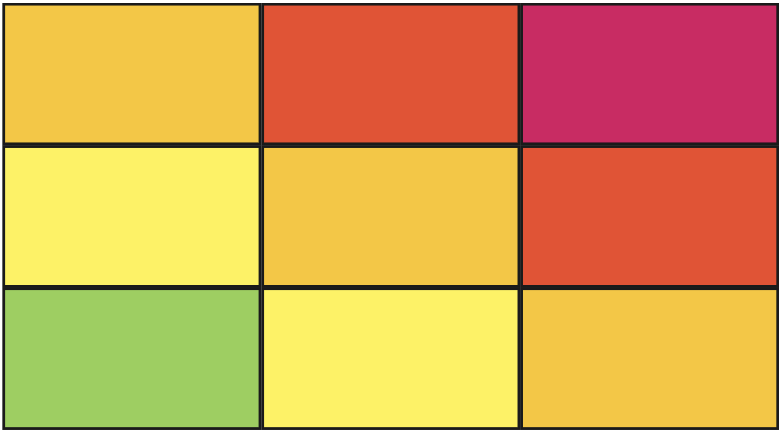

Add your risks to the Risk Board
Take the not storted risks and do relative estimation [1] with the two dimensions „Impact“ and „Propability“ [2] [1] https://www.agilealliance.org/glossary/relative-estimation
[2] https://riskstorming.com/
High
Propability
Low
High
Impact
Notes:
10 min

Slide 16
Add your risks to the Risk Board
High
Propability
Low
High
Impact
Notes:
10 min

Slide 17
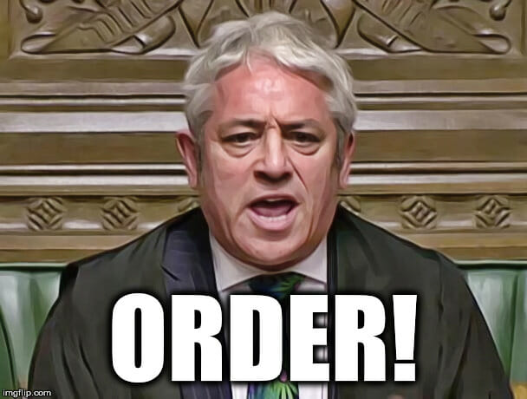
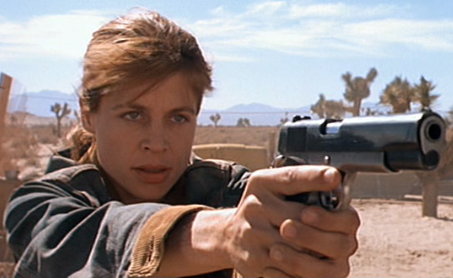
Identify your targets / Order your risks!
Order | Risk
1
2
3
4
5
6
7
8
9
10
Notes:
https://terminator.fandom.com/wiki/Sarah_Connor?file=Sarah_T2_gun.jpg

Slide 18
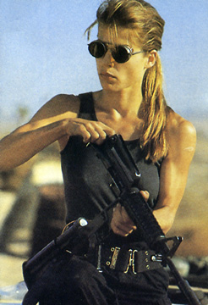
Create your strategy!
Order | Risk | 15% Solution | 85% Solution
1
2
3
4
5
6
7
8
9
10
Notes:
Images: https://terminator.fandom.com/wiki/Terminator_Wiki

Slide 19
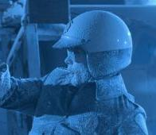
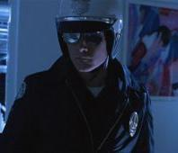
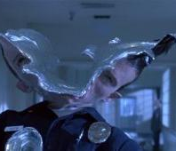
Is our strategy successful?
Notes:
https://terminator.fandom.com/wiki/

Slide 20

Rate the results, and the workshop
Notes:
https://commons.wikimedia.org/wiki/File:IMDB_Logo_2016.svg

Slide 21

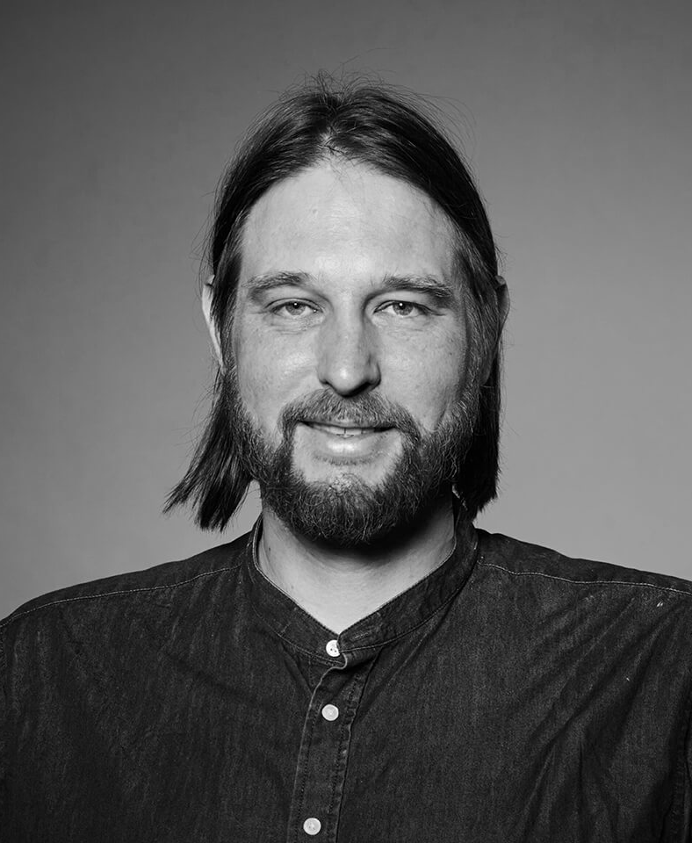
The Creators
Kira Naehring
https://www.linkedin.com/in/kiranaehring
Nils Hyoma:
https://www.linkedin.com/in/nils-hyoma-74a79244
https://twitter.com/nilsbert
https://medium.com/@nilsbert

